Slide 1
Dwell Time Aggregations

Slide 2
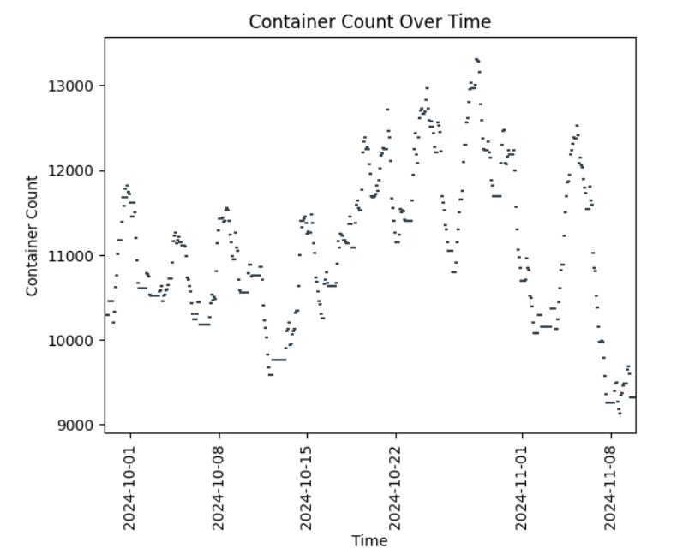
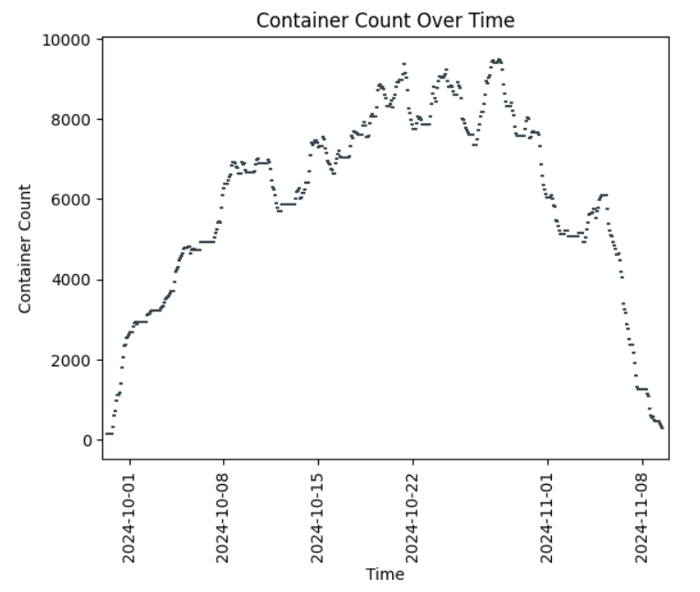
Mainsail Captures Only Half
Ratio Method
1
Mainsail Metric
2
1
3
3
Notes:
This is the heart of the matter. Here’s how the container count for T18 progressed over time during the reporting period. The graph on the left shows all the containers. The graph on the right shows the containers that were included in YRD120R. Note the different values on the vertical axis. The full daily container count is always much higher than the Mainsail count. You can visually average a function by imagining where a wire following the curve would balance on if your finger were placed horizontally underneath it. The set of all containers wanders around a value of approximately 11,100. The Mainsail report has a daily average of around 5,900 containers. Notice that the Mainsail set starts and ends with 0 because the containers must arrive and depart during the reporting period. Hence, no containers in YRD120R are on the terminal yet when the reporting period begins and all have left by the time it ends.

Slide 3
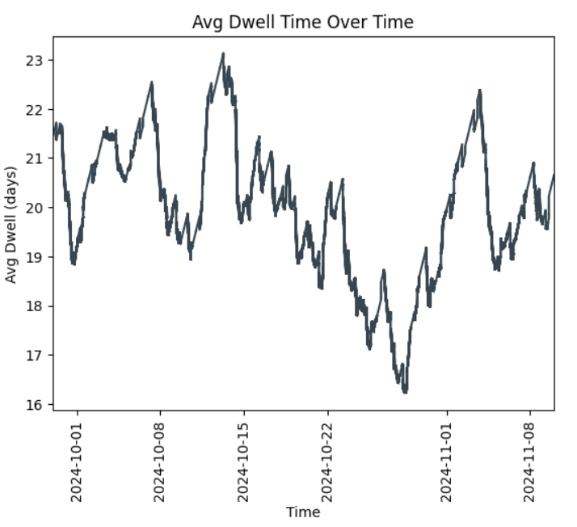
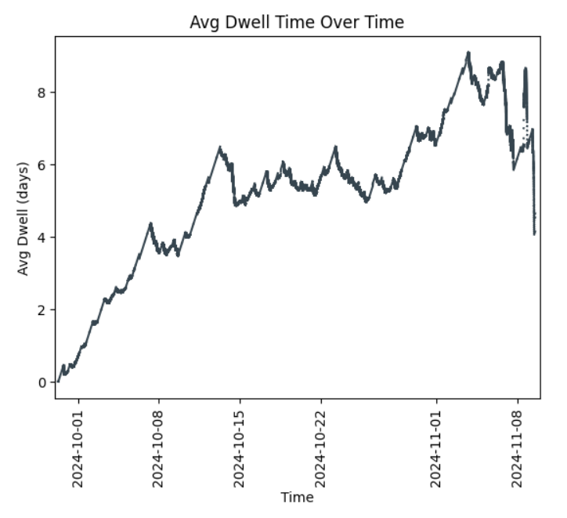
Aggregated Average Dwell Time Comparison
Ratio Method
Mainsail Metric
1
2
3
3
1
Notes:
The missing containers impact the computed average dwell time. On the left is a plot for the average dwell time over time for all the containers. On the right is the same plot for the containers that are included in the Mainsail metric. Again, the vertical axis scales are quite different as are the averages. The average dwell time for YRD120R again starts and ends with zero because of the requirement that all containers arrive and depart during the reporting period. The rise is slower than the drop because at the start only short-dwelling containers may be present. In contrast, at the end, containers that have been present for weeks all must leave causing the total dwell to crash to zero bringing the average dwell to zero with it.

Slide 4
Results of All Methods
Method | Avg Over Days (days) | Entire Period (days)
Integration | 19.9798 | 19.9798
Sampling | 20.1242 | 20.1242
Ratio | 19.9703 | 19.8891
Mainsail | 0.0000 | 5.7415
The Mainsail metric is too low by 71%.
Over the period it captures 53% of the container-days.
The missed containers have an avg dwell time of 36.2 days.
Notes:
Four methods were implemented in Python in a Jupyter notebook and compared given a six-week period at T18. The integration method is an exact method and gives the correct answer. Sampling and the ratio methods are approximate methods. The integration, sampling, and ratio methods agree to within 0.5% or so. The Mainsail metric is too low by 70+%, having only captured the shortest-dwelling half of the container-days spent on terminal during the period. The omitted half of the container-days had an average dwell of 36.2 days.

Slide 5
Conclusions
Crow’s Nest prefers the ratio method
Simple
Effective
Integration is not preferred due to its complexity
Sampling is not preferred due to its compute and storage requirements in the long term
The Mainsail metric is not preferred due to its lack of advantage relative to the other methods
Notes:
In conclusion, the Crow’s Nest is not currently intending to offer any aggregation on average dwell time other than the ratio method. It is implemented and under review and should be available in the dashboards in the coming weeks. The ratio method is simple and effective.
In contrast, the integration method is not simple, the sampling method will not age well, and the Mainsail method seems to offer little advantage.

Slide 6
Method Details

Slide 7

Average Dwell Time
Two dimensions of averaging
Over the set of containers
$${\left\langle d\right\rangle }_{C}=\frac{\sum_{C}{d_{c}}}{\left|C\right|}$$
Over the period
$${\left\langle d\right\rangle }_{C,T}=\frac{\int_{0}^{T}{{\left\langle d\right\rangle }_{C}}}{T}$$
Notes:
The aggregated average dwell time is a little tricky because you have to average over two dimensions. You average over the containers on the terminal at any given moment and then you average that over time. Calculus tells us how to average a function of time. You integrate it and divide by the period.

Slide 8
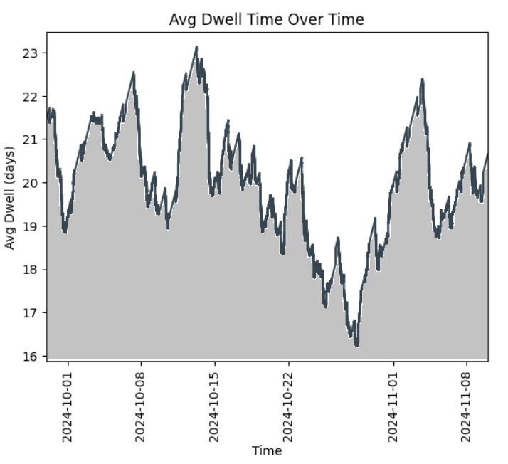
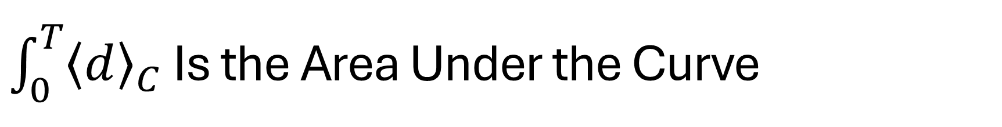
$\int_{0}^{T}{{\left\langle d\right\rangle }_{C}}$ Is the Area Under the Curve
Notes:
Integration is something that we can do. It’s just the area under the curve, and if I can plot the curve then I can compute its area. This is a plot of the average dwell time over a six-week period from the end of September to the beginning of November for T18. The area under it is shown in gray except that it would go all the way down to 0 and not stop at 16 like it does here.

Slide 9
Integration Is Hard
Requires working with individual inventory change events
Complex to build, maintain, and enhance
More likely to break and will arrive at end-of-life sooner
Filtering must be done during development
Imports/exports/transships/storage
Fulls/empties
Ad hoc filters cannot be implemented in the dashboards
New filters will likely take weeks to months
Notes:
We can implement integration and I have in the notebook that I shared, but it’s hard to do. It’s complex. You have to work with every event where a box comes or goes from the terminal. Complexity is really bad, especially at the start of a project. It means that everything associated with it will be more fragile and more costly and won’t last as long. Another issue with using integration is that you won’t be able to filter the containers in the dashboards any way you want. Instead, you’ll have to tell us in advance what filters you want and any new filters will take weeks to months to deliver. We don’t want to build the integration method for averaging a function.

Slide 10
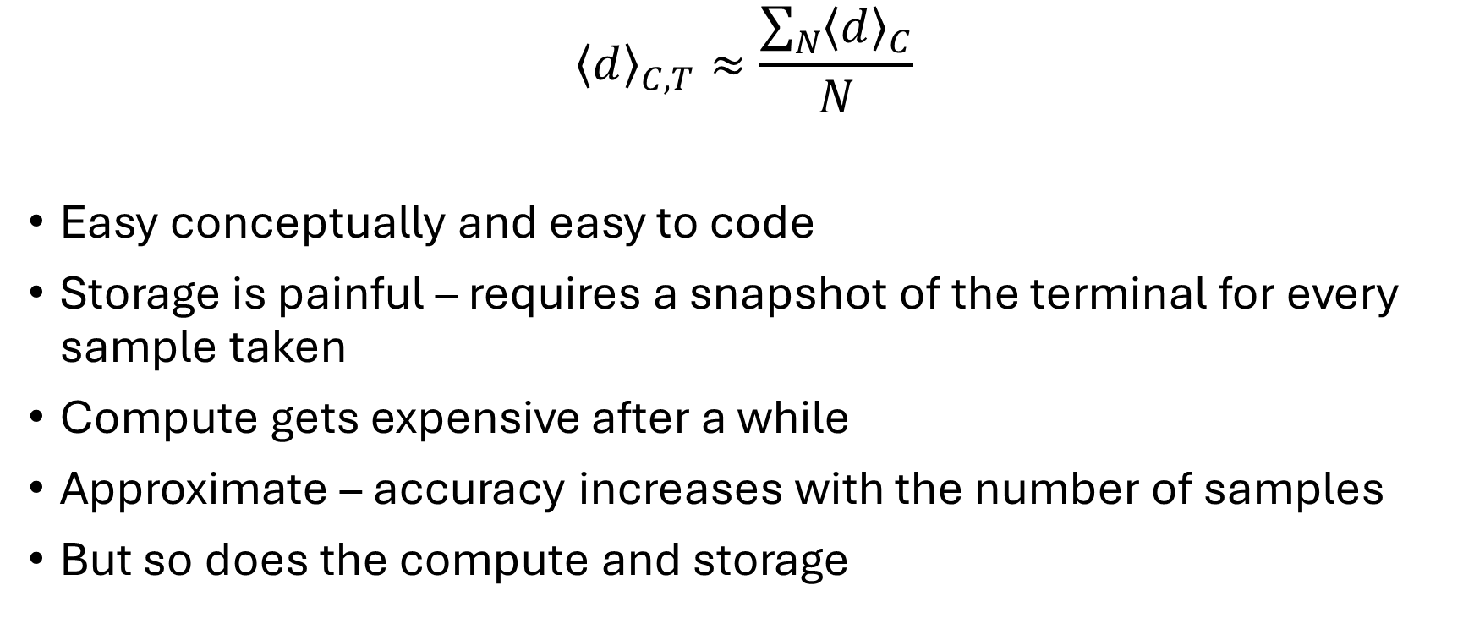
Sampling Is Intensive
$${\left\langle d\right\rangle }_{C,T}≈\frac{\sum_{N}{{\left\langle d\right\rangle }_{C}}}{N}$$
Easy conceptually and easy to code
Storage is painful – requires a snapshot of the terminal for every sample taken
Compute gets expensive after a while
Approximate – accuracy increases with the number of samples
But so does the compute and storage
Notes:
Sampling is easy enough, both conceptually and to code. Just take a snapshot of the data every so often so that you can go back and compute the metrics as they were at that time. This works great in the short term. In the long term it gets resource intensive. The snapshots take up a lot of space and get unwieldy. The accuracy can be improved by taking more samples, but that also increases the compute and storage costs.

Slide 11
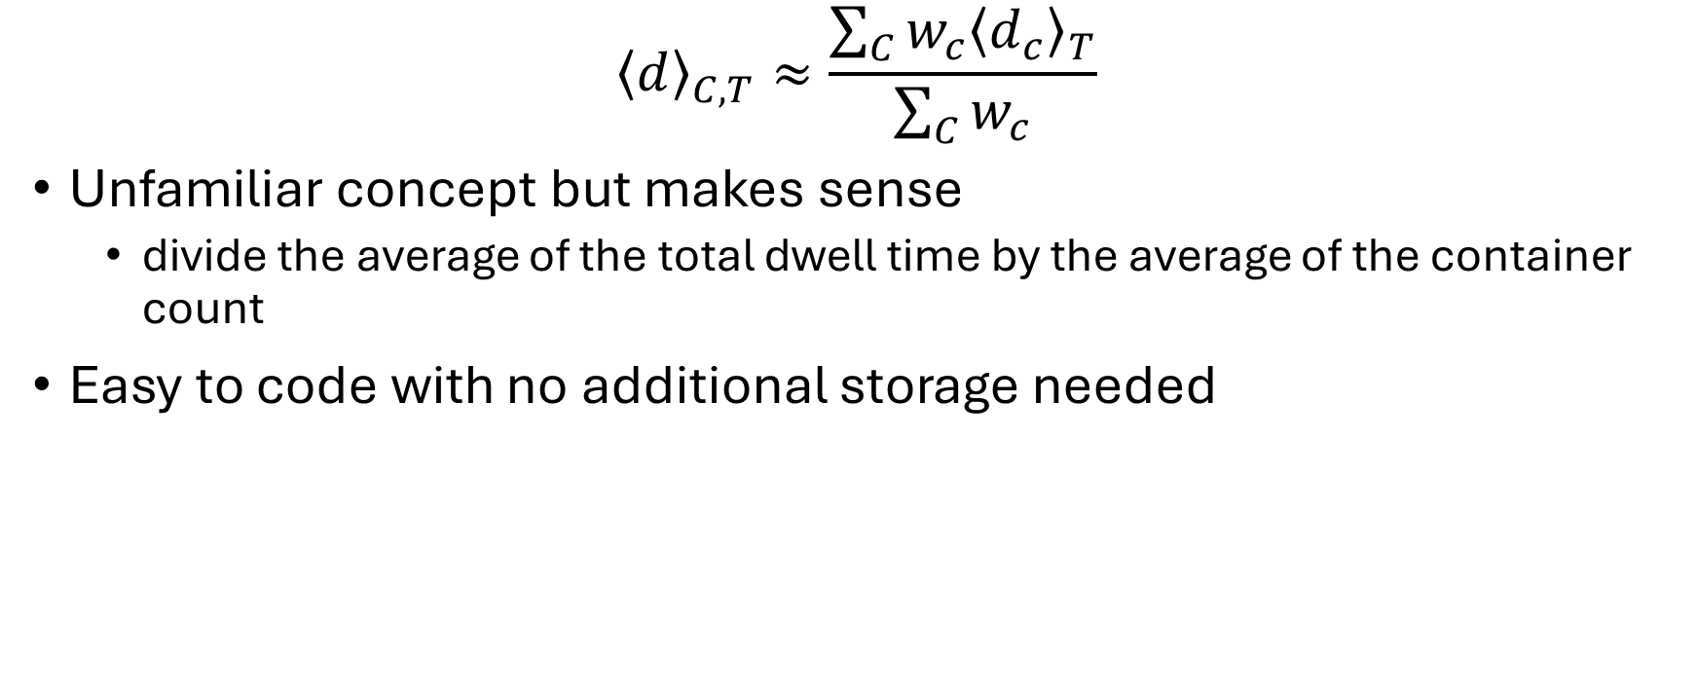
Preferred Method: Ratio Method
$${\left\langle d\right\rangle }_{C,T}≈\frac{\sum_{C}{w_{c}{\left\langle d_{c}\right\rangle }_{T}}}{\sum_{C}{w_{c}}}$$
Unfamiliar concept but makes sense
divide the average of the total dwell time by the average of the container count
Easy to code with no additional storage needed
Notes:
The ratio method cleaves the heart of the complexity in two. It ignores that the total dwell and container count need to be carefully paired together and instead just takes the average value of each and divides them together. For our circumstances where the total dwell and container counts have low variability and are correlated, the ratio method is expected to be a good approximation. However, that’s not really known until both the ratio and the integration methods are implement and compared. I am happy to report that I have done that comparison and for the average dwell time, the ratio method is a good approximation.

Slide 12
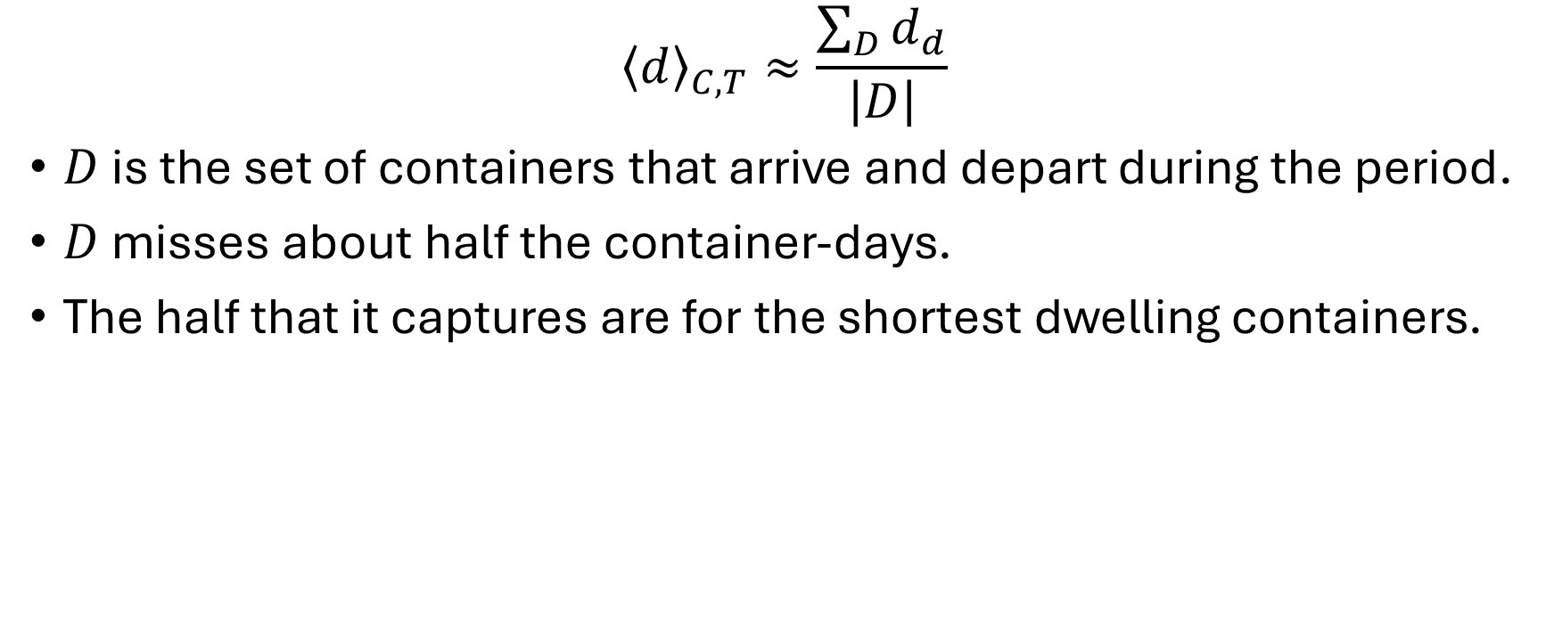
Mainsail Metric
$${\left\langle d\right\rangle }_{C,T}≈\frac{\sum_{D}{d_{d}}}{\left|D\right|}$$
$D$ is the set of containers that arrive and depart during the period.
$D$ misses about half the container-days.
The half that it captures are for the shortest dwelling containers.
Notes:
To be included in the YRD120R report that I received, the container had to arrive and depart during the reporting period. That causes Mainsail to miss a lot of container-days. This might not be so bad except that the selection process is strongly biased toward selecting the shortest dwelling containers. The longest possible dwell that YRD120R can report on is the length of the reporting period. This excludes a portion of the containers in the yard that have a strong affect on the average dwell time because they have such large values for their dwell.

